Slide 1
PODALJŠANO BIVANJE 2, 3 in 5
Pripravila: Katja Vraničar, prof. RP

Slide 2

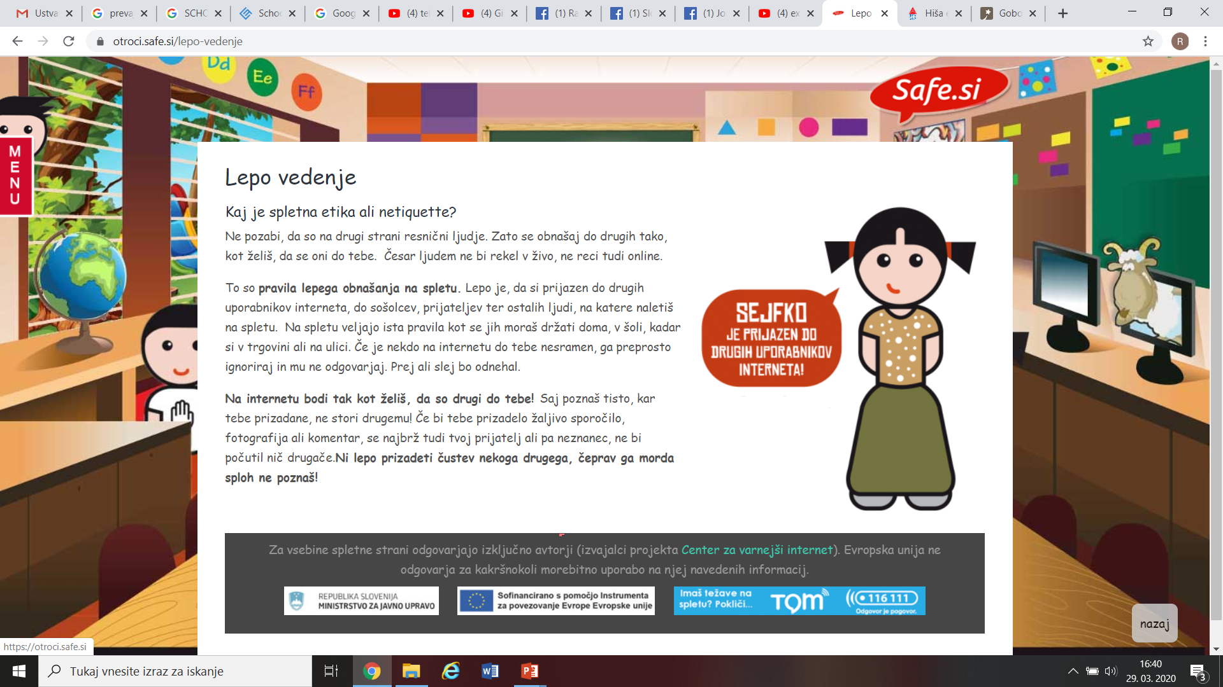
VARNA RABA SPLETA
Vir:
https://otroci.safe.si/lepo-vedenje

Slide 3
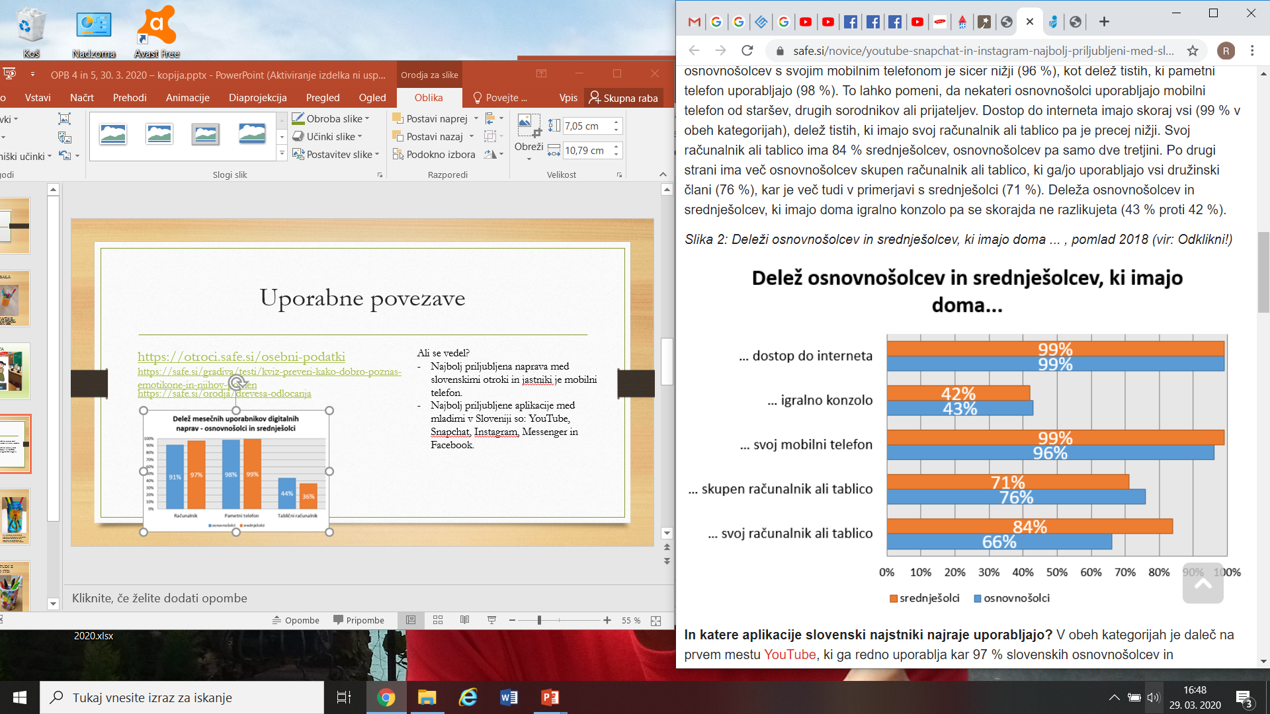
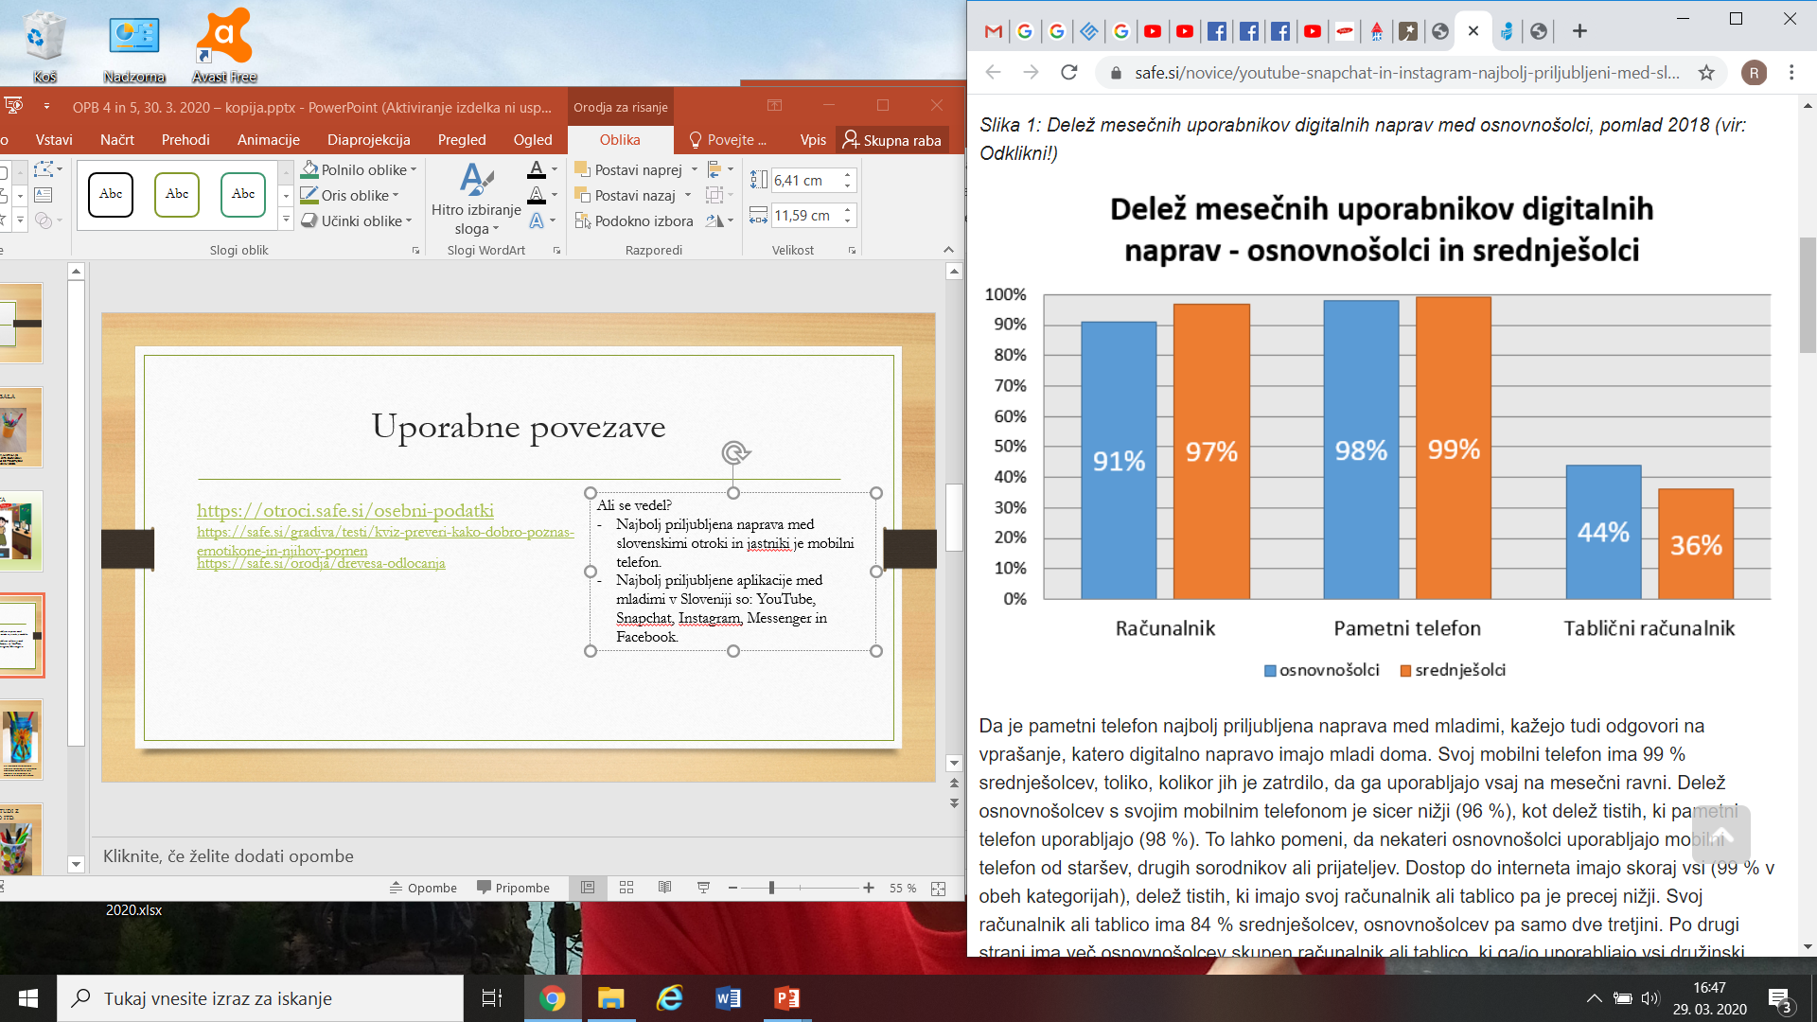
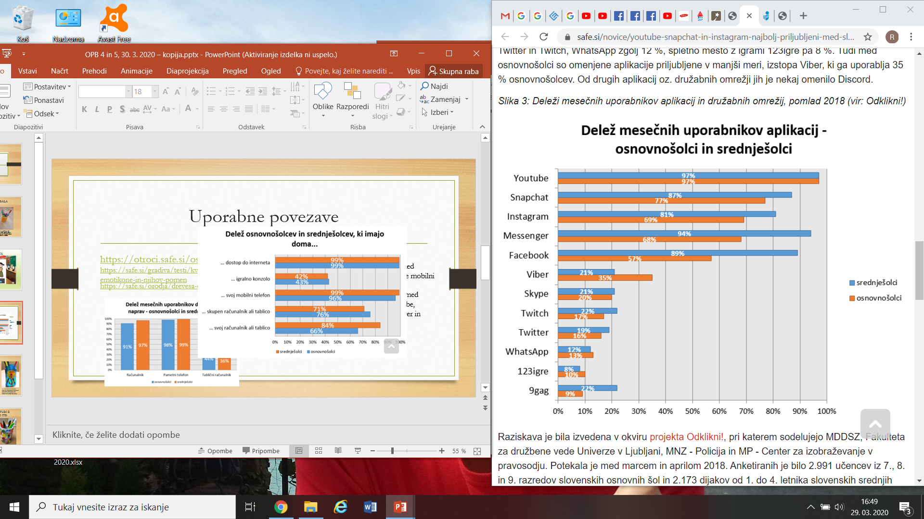
Ali si vedel?
Najbolj priljubljena elektronska naprava med
slovenskimi otroki in najstniki je mobilni telefon.
Vir:
https://safe.si/novice/youtube-snapchat-in-instagram-najbolj-priljubljeni-med-slovenskimi-najstniki

Slide 4

Uporabne povezave
https://safe.si/gradiva/testi/kviz-preveri-kako-dobro-poznas-emotikone-in-njihov-pomen
https://safe.si/orodja/drevesa-odlocanja
http://www.ris.org/c/1321/obiskanost_strani/?preid=0
https://safe.si/gradiva/testi/kviz-ali-delis-prevec-neprimernih-vsebin-na-druzabnih-omrezjih
Notes:
Vir: https://www.google.com/search?q=safe+internet&rlz=1C1CHBF_slSI814SI814&sxsrf=ALeKk00DxWiCKR6e4k4mRIjNeOyIJ6XGpA:1585493705725&source=lnms&tbm=isch&sa=X&ved=2ahUKEwjkif6o-L_oAhXKNcAKHXmTDXEQ_AUoAXoECBEQAw&biw=1536&bih=754#imgrc=8ux_Zweyry4kFM

Slide 5
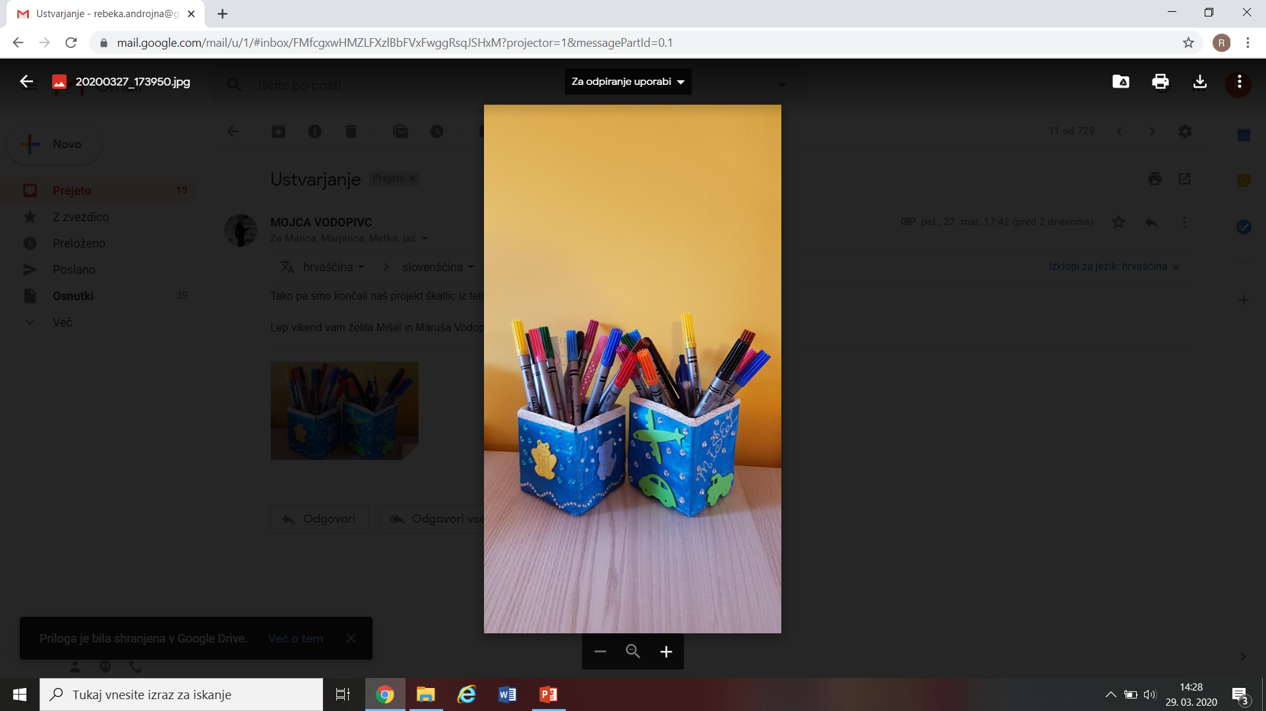
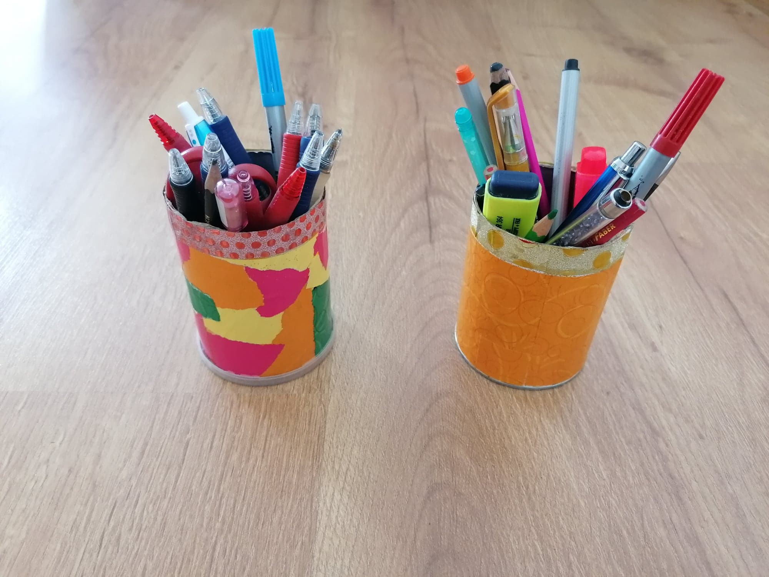
IZDELAJ LONČEK ZA PISALA
Miha in Maruša sta naredila svoje lončke za pisala iz odpadne embalaže za mleko. Okrasila sta jih z bleščečim papirjem in biserčki.
Ta lončka za pisala sta nastala iz odpadne embalaže za čips. Okrašena sta z ostanki papirja, ki so prilepljeni z mešanico lepila za les in vode.
Notes:
Vir: lastni arhiv

Slide 6
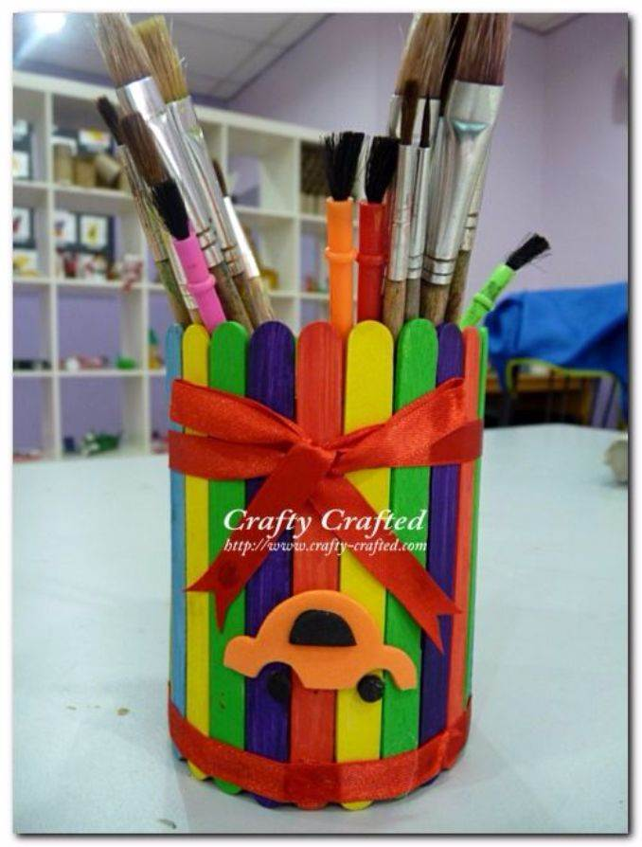
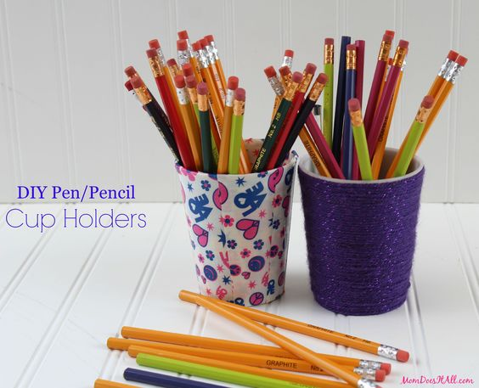
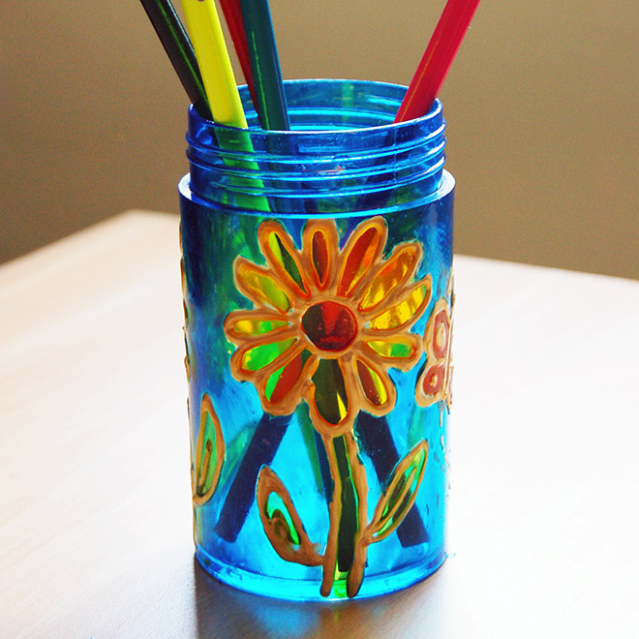
Lonček lahko izdelaš tudi iz kartonastih skodelic za kavo …
Za izdelavo steklenega lončka potrebuješ stekleno odpadno embalažo (npr. Kozarci za vlaganje) in barve za risanje po steklu.
… ali sladolednih paličic.
Notes:
Vir: https://www.google.com/imgres?imgurl=https%3A%2F%2Fwww.familyholiday.net%2Fwp-content%2Fuploads%2F2016%2F07%2FDIY-pencil-holder-ideas-for-your-home-desk-decoration-17.jpg&imgrefurl=https%3A%2F%2Fwww.familyholiday.net%2F23-creative-and-unusual-diy-pencil-holder-ideas-for-your-home-desk-decoration%2F&tbnid=sj51LMQYD0MNSM&vet=12ahUKEwi0j4zW2r_oAhUL_BoKHYPEAggQMyhAegUIARCQAQ..i&docid=qV3Iew4c_QyTNM&w=678&h=894&q=PENCIL%20CUP%20HOLDER%20HOME%20MADE&ved=2ahUKEwi0j4zW2r_oAhUL_BoKHYPEAggQMyhAegUIARCQAQ

Slide 7
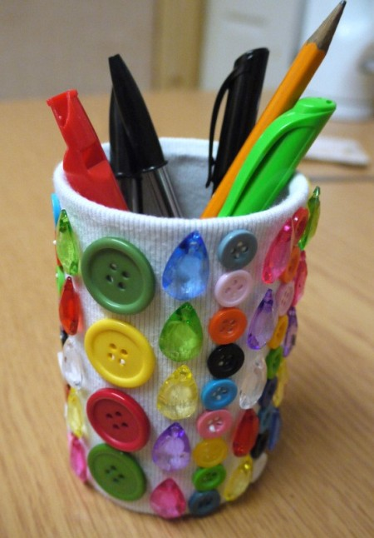
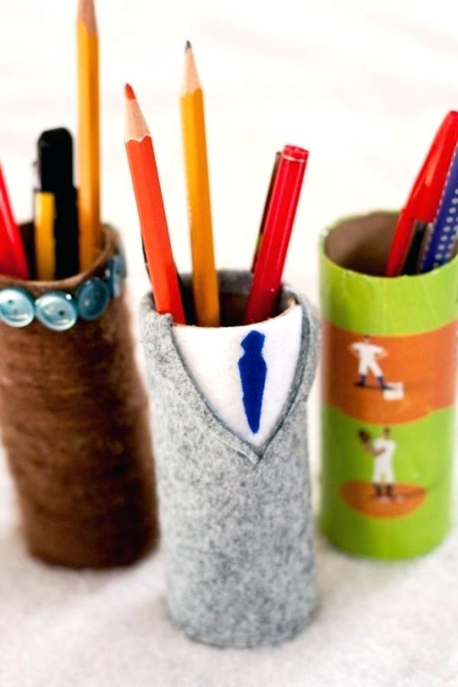
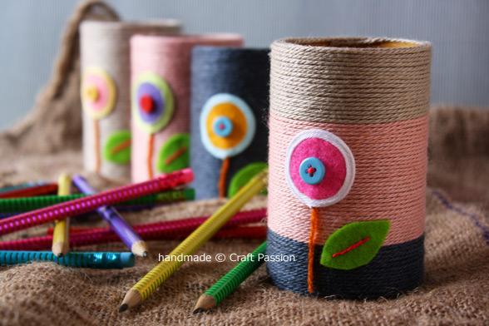
Lončke lahko okrasiš tudi z blagom, filcem, volno itd.
Notes:
Vir: https://www.google.com/imgres?imgurl=https%3A%2F%2Fi.shelterness.com%2F2018%2F08%2Ffun-diy-pencil-holders-and-cups-for-kids-5.jpg&imgrefurl=https%3A%2F%2Fwww.shelterness.com%2Fdiy-kids-pencil-holders-cups%2F&tbnid=YJhCHbHbfoTs2M&vet=10CMcBEDMotgFqFwoTCNis8dfav-gCFQAAAAAdAAAAABAH..i&docid=anF_MZAzp2EjEM&w=588&h=392&q=PENCIL%20CUP%20HOLDER%20HOME%20MADE&ved=0CMcBEDMotgFqFwoTCNis8dfav-gCFQAAAAAdAAAAABAH
https://www.google.com/imgres?imgurl=https%3A%2F%2Fimg.thrfun.com%2Fimg%2F116%2F266%2Fbutton_and_jewel_pencil_pot_17_m6.jpg&imgrefurl=https%3A%2F%2Fwww.thriftyfun.com%2FPen-and-Pencil-Holder-Ideas.html&tbnid=RTHFF91Qahw2aM&vet=10COEBEDMowAFqFwoTCNis8dfav-gCFQAAAAAdAAAAABAH..i&docid=rDQJUHRokDRAOM&w=450&h=646&q=PENCIL%20CUP%20HOLDER%20HOME%20MADE&ved=0COEBEDMowAFqFwoTCNis8dfav-gCFQAAAAAdAAAAABAH
https://www.google.com/imgres?imgurl=https%3A%2F%2Fi.ytimg.com%2Fvi%2FbOERfSDmURM%2Fhqdefault.jpg&imgrefurl=https%3A%2F%2Fwww.youtube.com%2Fwatch%3Fv%3DbOERfSDmURM&tbnid=mu3l6R4eDBpsAM&vet=12ahUKEwi0j4zW2r_oAhUL_BoKHYPEAggQMygYegQIARAz..i&docid=6iLAGj7_o3S2sM&w=480&h=360&itg=1&q=PENCIL%20CUP%20HOLDER%20HOME%20MADE&ved=2ahUKEwi0j4zW2r_oAhUL_BoKHYPEAggQMygYegQIARAz

Slide 8
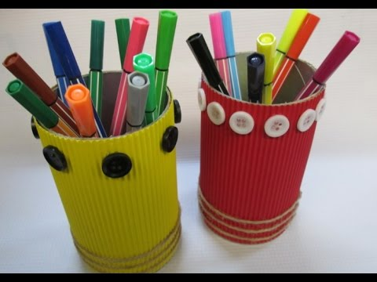
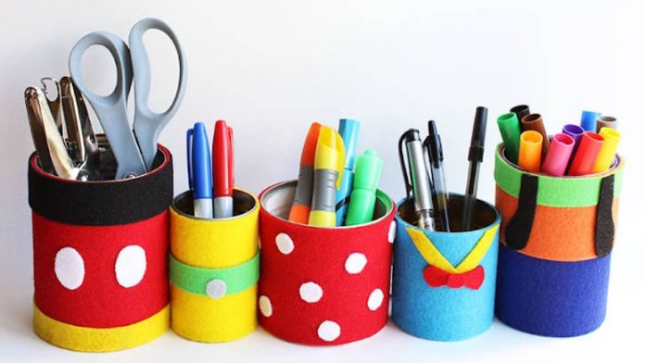
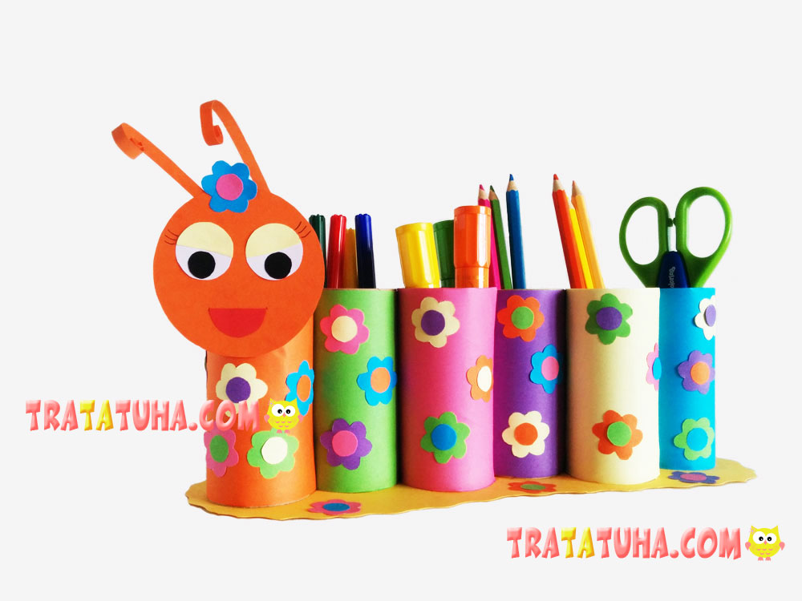
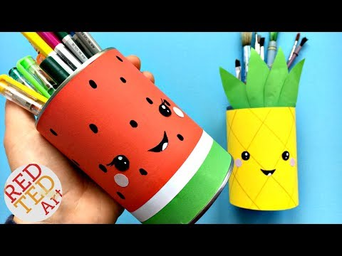
ŠE NEKAJ IDEJ
Notes:
Vir: https://www.google.com/imgres?imgurl=https%3A%2F%2Fi.ytimg.com%2Fvi%2Fpgrqakwf0Aw%2Fhqdefault.jpg&imgrefurl=https%3A%2F%2Fwww.youtube.com%2Fwatch%3Fv%3Dpgrqakwf0Aw&docid=STFChjFiSstxHM&tbnid=gosFGWC__QobJM%3A&vet=1&w=480&h=360&itg=1&bih=730&biw=1050&ved=2ahUKEwj6quKF3L_oAhUQGewKHTNXBfwQxiAoAnoECAEQHA&iact=c&ictx=1
https://www.google.com/imgres?imgurl=https%3A%2F%2Ftratatuha.com%2Fwp-content%2Fuploads%2F2019%2F01%2FToilet-Paper-Roll-Caterpillar-Pencil-Holder1.jpg&imgrefurl=https%3A%2F%2Ftratatuha.com%2Ftoilet-paper-roll-caterpillar-pencil-holder.html&docid=H0USglFD_rGjNM&tbnid=Z9snJ1p8sTKqsM%3A&vet=1&w=1000&h=750&itg=1&bih=730&biw=1050&ved=2ahUKEwj6quKF3L_oAhUQGewKHTNXBfwQxiAoB3oECAEQKw&iact=c&ictx=1
https://www.google.com/imgres?imgurl=https%3A%2F%2Fi.pinimg.com%2Foriginals%2F1f%2Ff8%2Fd2%2F1ff8d2facdfd078a281e0a1f777f465c.jpg&imgrefurl=https%3A%2F%2Fwww.pinterest.com%2Fpin%2F12807180163120967%2F&tbnid=7HPxOJt5fNz77M&vet=10CA0QxiAoA2oXChMI2Kzx19q_6AIVAAAAAB0AAAAAEAU..i&docid=g7zU1kp9hGSYcM&w=599&h=844&itg=1&q=PENCIL%20CUP%20HOLDER%20HOME%20MADE&ved=0CA0QxiAoA2oXChMI2Kzx19q_6AIVAAAAAB0AAAAAEAU#h=844&imgdii=rh1jtlgwyzBfqM:&vet=10CA0QxiAoA2oXChMI2Kzx19q_6AIVAAAAAB0AAAAAEAU..i&w=599

Slide 9

Želim vam prijeten in miren teden.
Notes:
Vir: https://www.google.com/search?q=nature+background&tbm=isch&ved=2ahUKEwiRp4W5p8DoAhWXBhoKHb4NCSIQ2-cCegQIABAA&oq=nature+background&gs_lcp=CgNpbWcQAzICCAAyAggAMgIIADICCAAyAggAMgIIADICCAAyAggAMgIIADICCAA6BwgjEOoCECc6BAgjECc6BAgAEENQx6wEWL_NBGCczgRoAXAAeACAAWaIAe8LkgEEMTUuMpgBAKABAaoBC2d3cy13aXotaW1nsAEK&sclient=img&ei=M-iAXtHBNJeNaL6bpJAC&bih=754&biw=1536&rlz=1C1CHBF_slSI814SI814#imgrc=kuDDaeei731YVM&imgdii=4GtNfhs1W7_snM

